Slide 1

以Qt 實作結合圖像識別之互動系統
組長:50915109 莊捷森
組員:50915133 陳有臨、50915110 陳霑汶

Slide 2
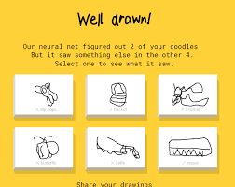
開發背景與目標
靈感來源於 Quick, Draw!
由Google開發的一款線上遊戲，玩法是由玩家按所給題目繪出圖形，同時由人工神經網絡來猜測圖形所代表的內容，猜中即為成功。
開發目標
利用 Qt ，實現一個結合畫布繪製與 AI 圖像分類的桌面應用程式。

Slide 3
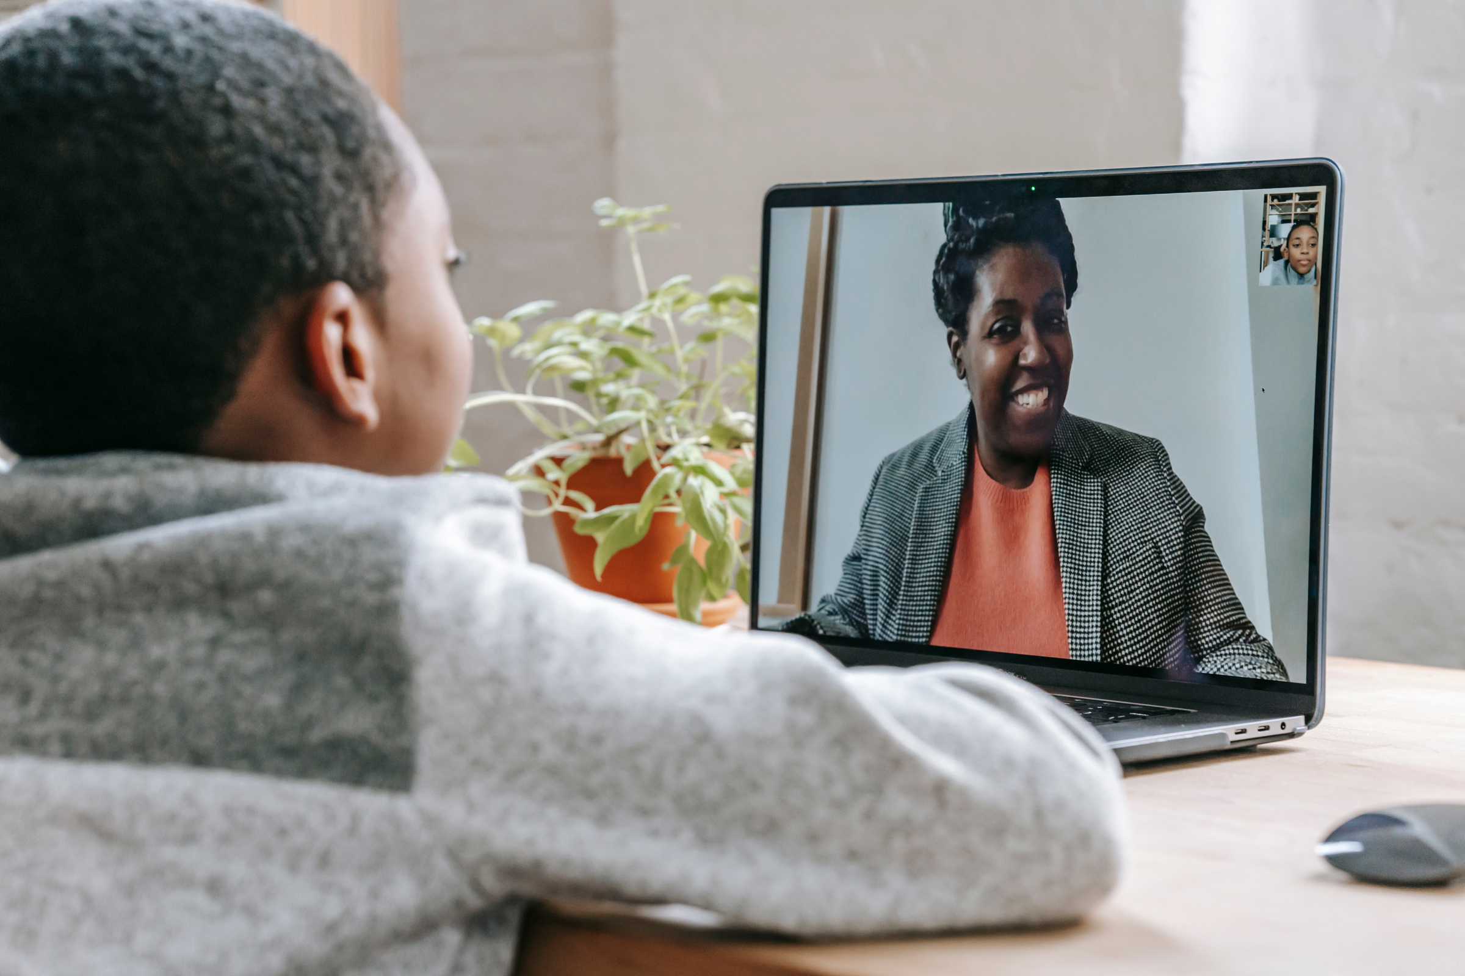
系統流程
System Flow

Slide 4
Demo影片

Slide 5
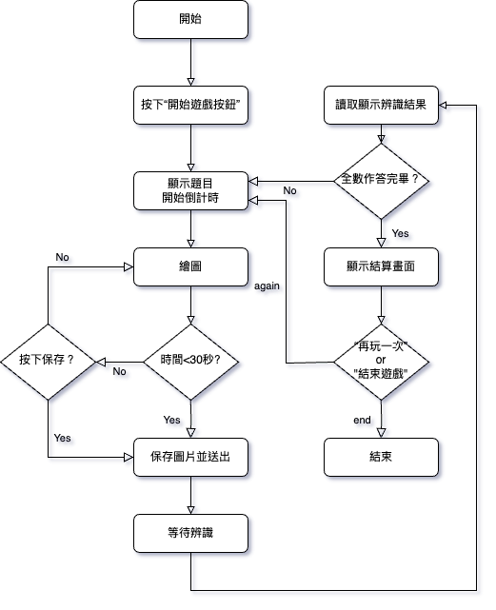
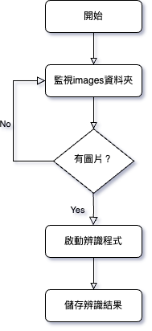
Qt
py

Slide 6
技術實現
Implementation Technique

Slide 7
技術架構
系統架構
開發環境與工具
技術分工
前端 (Qt)：負責畫布繪製、互動與文件監控。
後端 (Python + TFLite)：負責圖片識別與結果生成。
整合:畫布數據轉換指定格式。使用文件共享方式將畫布資料傳送至 AI 推理模組。
Qt 6.8.1 (C++ 開發)
Python 3.9 (視覺辨識模型與文件監控)
TensorFlow Lite 模型
Visual Studio Code 與 Qt Creator IDE
Qt：畫布、界面、互動、計時與總結頁面。
AI 模型：圖像分類與辨識。

Slide 8
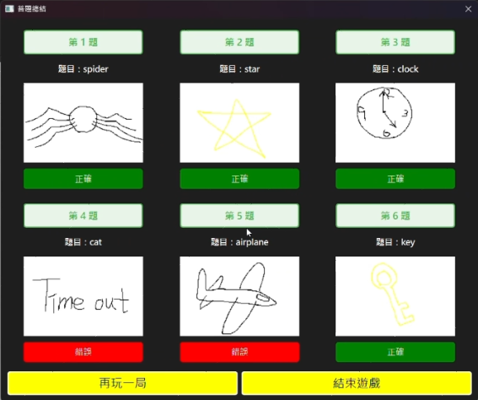
Qt 技術實現
畫布繪製與工具實現
使用 Canvas創建畫布並使用QPainter 進行繪圖。
文件監控與處理
使用 QFile 實時監控 result.txt，讀取最新的辨識結果、提取內容進行解析，並通過 QTimer 定時檢測文件變化。
Layout
使用 QGridLayout 排列圖片與文字
根據 result.txt 的內容解析每一題結果，動態生成 QLabel 與 QPixma
使用 QDialog 顯示總結頁面，支持動態布局。

Slide 9

AI 技術整合
Model
使用 TensorFlow 訓練一個 CNN（卷積神經網絡）模型進行 10 類別圖像分類，類別包括 "airplane", "bus", "cat", "clock", "fish", "flower", "key", "spider", "star", "tree"。
Dataset
使用 Google Quick, Draw! 的開源數據作為基礎。

Slide 10
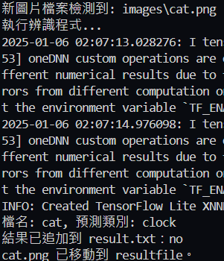
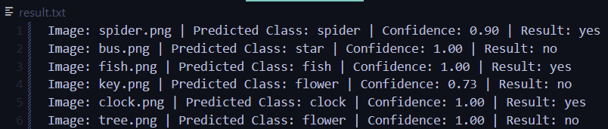
模型推理過程與 和Qt 的交互
Input
監測到有圖片存儲於指定資料夾。
Pre-processing
將圖片縮放、正規化，調整為模型可接受的格式。
Output
返回分類結果（類別名稱）與信心分數（Confidence Score）根據預測結果和文件名稱比較生成 yes/no 判定。

Slide 11
題目
辨識類別
Confidence Score
結果

Slide 12
Q&A

Slide 13
Thanks for listening

Slide 14
模型推理過程
Input
監測到有圖片存儲於指定資料夾。
Pre-processing
將圖片縮放、正規化，調整為模型可接受的格式。
Output
返回分類結果（類別名稱）與信心分數（Confidence Score）根據預測結果和文件名稱比較生成 yes/no 判定。

Slide 15
Large scale
This service is offered worldwide, widening our reach and market.
Different approach
Not just a notes sharing app, but a lesson sharing app for teachers too.
Experience
Our management has experience in the educational sector.
Values
We heavily believe in the power of education, and that is our driving force.

Slide 16
Solutions
Technologically and socially, online learning can be very limiting. But technological advances also give us the possibility to break borders.
Shared spaces
Online lesson database
Closed forums
A library where you can share notes and resources
A place where teachers can share lesson plans and recorded sessions
Online "classrooms" where students can meet and discuss

Slide 17
Where We Started
A dorm room idea turned start-up, the very first ScoutNotes was started as an on-campus app.
2017
2019
2021
PRE-SEED FUNDING
SEED FUNDING
SERIES A FUNDING
NEXT STEPS

Slide 18

Why Now?
The way of the future
Virtual learning saves resources and time for everyone. Eventually, physical classes will be phased out.
Technologically-ready
Most students and teachers today have the technology at home to keep up with the demands of virtual learning
Preparing for "emergencies"
This pandemic has shown us that nothing is stagnant, and we have to be prepared for changes in the blink of an eye

Slide 19
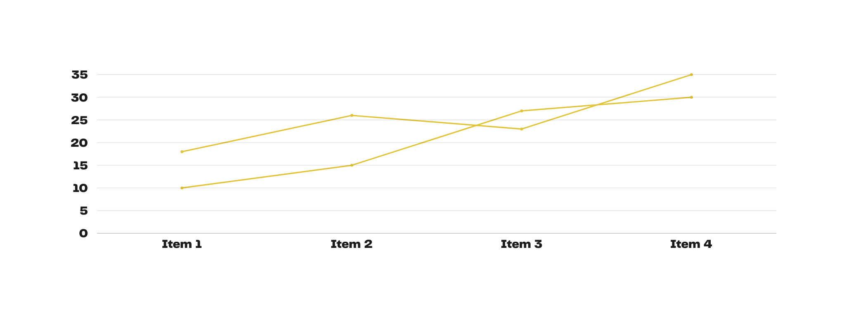
Traction
An increase in demand for online learning resources

Slide 20
Our Audience
Both learners and educators alike will benefit from ScoutNotes
High school and university students
ScoutNotes gives them an opportunity to connect with other learners in similar classes worldwide.
Teachers and professors
ScoutNotes can help them reach out to their own students, and to students and other educators from outside their classroom.

Slide 21
Market Size
1.9 Billion
53 M
10 M
Total Available Market
Serviceable Available Market
Market Share

Slide 22
Indirect Competitors
Direct Competitors
Studypub
Scientor
Etherlearning
Cheat Sheet Study Co.
V-Studies
Learned Minds Hub

Slide 23

Competitive Advantages

Slide 24
Large scale
This service is offered worldwide, widening our reach and market.
Different approach
Not just a notes sharing app, but a lesson sharing app for teachers too.
Experience
Our management has experience in the educational sector.
Values
We heavily believe in the power of education, and that is our driving force.

Slide 25
Competitor Approach
Free for students and educators
More than note
Sharing
Larger market
Our service will be 100% free for students and teachers. The cost will be paid by membership plans through schools.
To make education accessible, we will open up our market. Students and teachers can connect to others who are in the same classes and fields.
We aim to be a virtual library. Our database can be used to store lectures and resources that are accessible to others in the same area of study.

Slide 26
The Business Model
These are our initial paid plans.
BASIC
Up to one "classroom". Full access for 30 students and 2 teachers.
PRO
Up to one year level. Full access for 100 students and 10 teachers.
UNLIMITED
Full access to all students and teachers within one school.

Slide 27



Meet the Team
CAHAYA DEWI
HARUMI KOBAYASHI
YANIS PETROS
Chief Executive Officer
Chief of Operations
Chief Product Officer

Slide 28
2025
Series B Funding
Future Roadmap
2027
Series C Funding
We're looking to expand outside of North America and hit the Asian and European markets.
2028
Private Funding

Slide 29

Contact Us
123-456-7890
HELLO@REALLYGREATSITE.COM
WWW.REALLYGREATSITE.COM

Slide 30

























Free Resources
Use these free recolorable icons and illustrations in your Canva design

